Slide 1
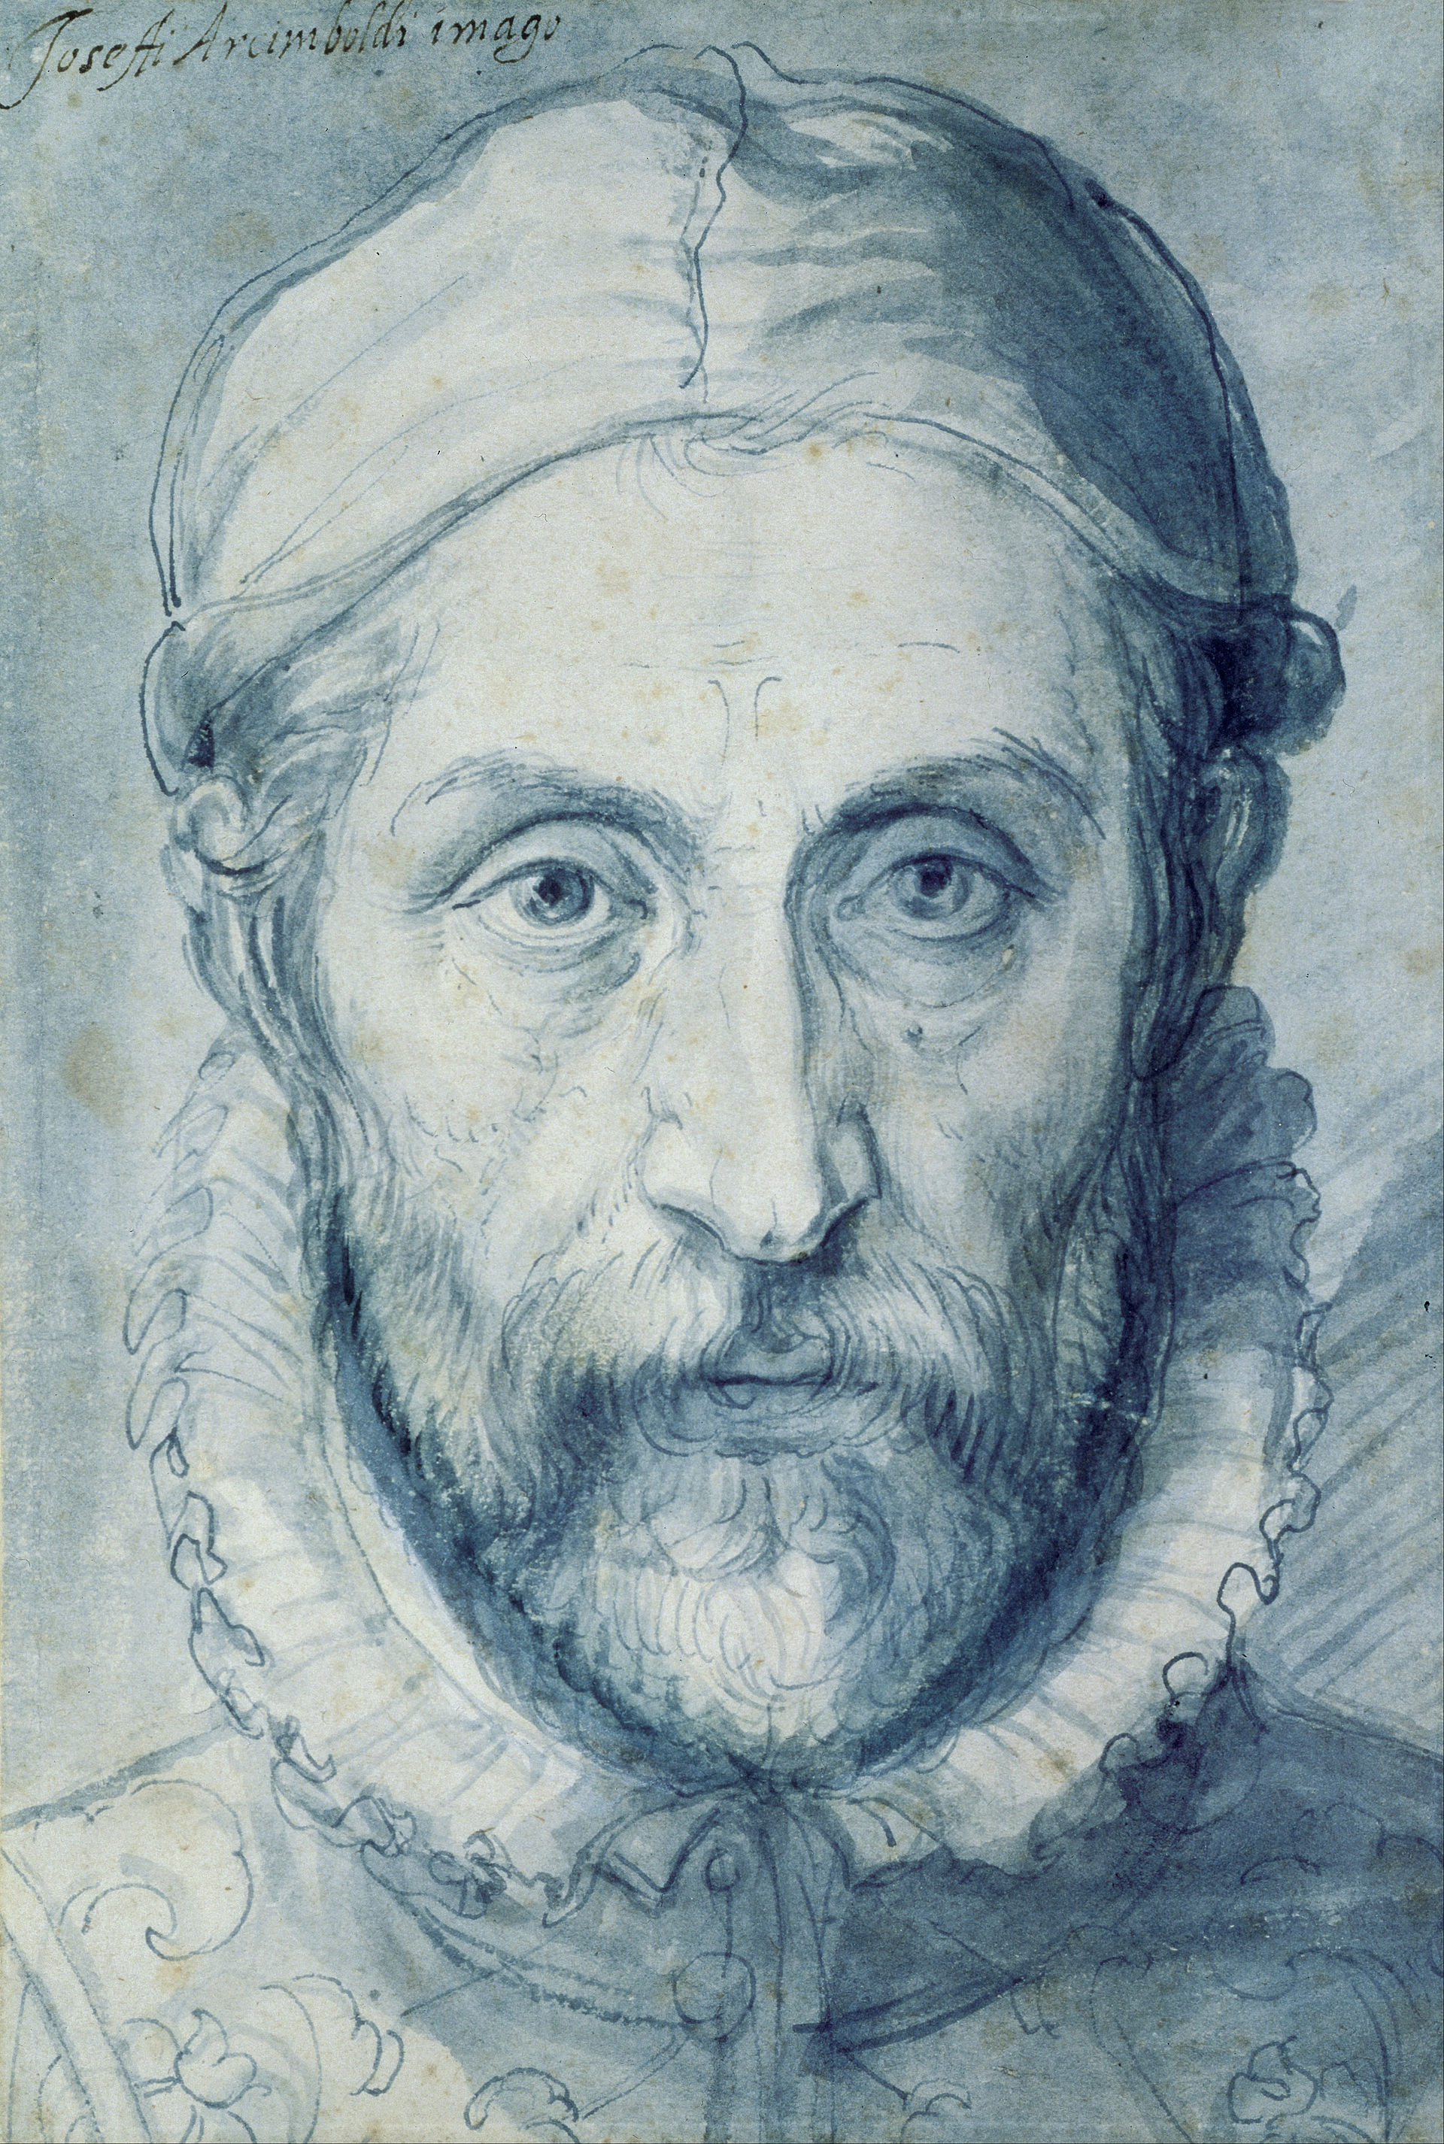
Giuseppe Arcimboldo 1527 - 1593
Arcimboldo started his career as a designer of stained glass and frescoe painter in Milan.
In 1562 he became court portraitist to Ferdinand I in Vienna and later to Maximillian II and his son Rudolph II in Prague.
He was also court decorator and costume designer.
He specialized in grotesque symbolical compositions of fruit, animals, landscapes and a variety of inanimate objects, mainly as whimsical curiosities to amuse the courts.
When Arcimboldo died, his Italian contemporaries honoured him with poetry and manuscripts celebrating his illustrious career.
This Photo by Unknown Author is licensed under CC BY-SA

Slide 2
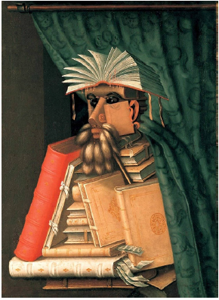
The Librarian
The Librarian is one of a series of paintings of the entourage of Maximillian II.
Arcimboldo used objects signifying book culture at that time. The curtains which created individual study rooms, animal tail dusters became the beard.
The work is both a celebration and a satirical mocking of scholarship; a parody of ‘materialistic book collectors more interested in aquiring books than in reading them’.
This Photo by Unknown Author is licensed under CC BY-SA

Slide 3
The Four Seasons
A set of four portraits, each made up of fruits, vegetables and plants relating to the relevant season.
The set was offered to Maximillian II in 1569
The set was accompanied by a poem by Giovanni Battista Fonteo explaining their allegorical meaning.
This Photo by Unknown Author is licensed under CC BY-SA

Slide 4
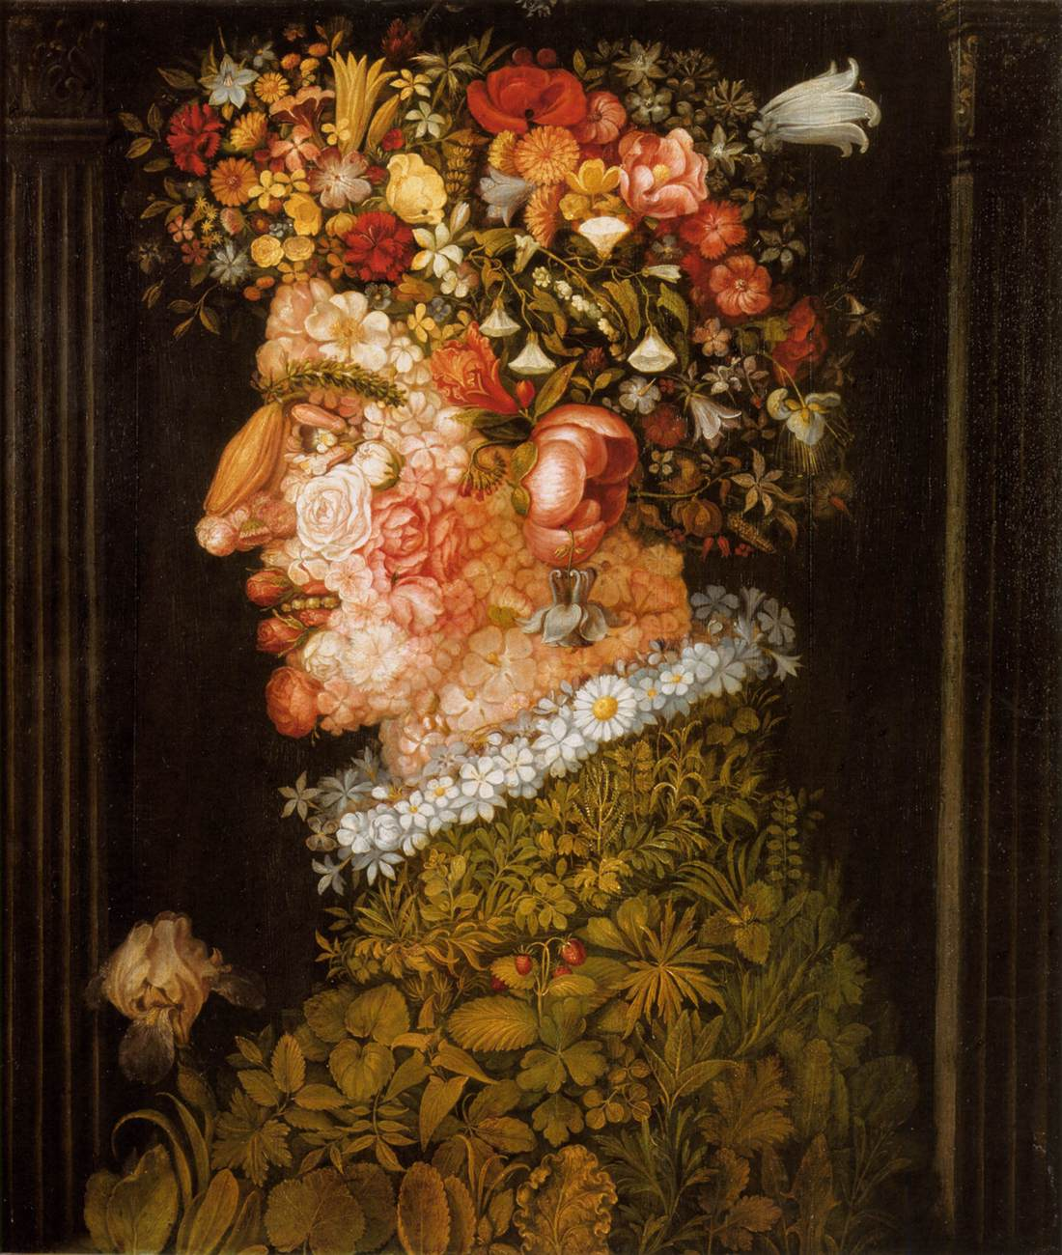
Spring
The whole figure is composed of a wide variety of flowers, with head facing left.
The skin of the face and lips are rose petals and buds and the eyes are belladonna berries.
The hair is a colourful and lush bouquet.
A daisy necklace adorns the neck whilst the body is a jungle of different shaped leaves.
This Photo by Unknown Author is licensed under CC BY-SA

Slide 5
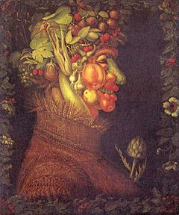
Summer
Unlike Spring this portrait faces right and is made up of fruits and vegetables.
Cherries adorn the hair and upper lip, the check is a peach, the nose a cucumber, the ear an eggplant and the eyebrow an ear of wheat.
The clothing is straw and an artichoke adorns the chest.
This Photo by Unknown Author is licensed under CC BY-SA

Slide 6
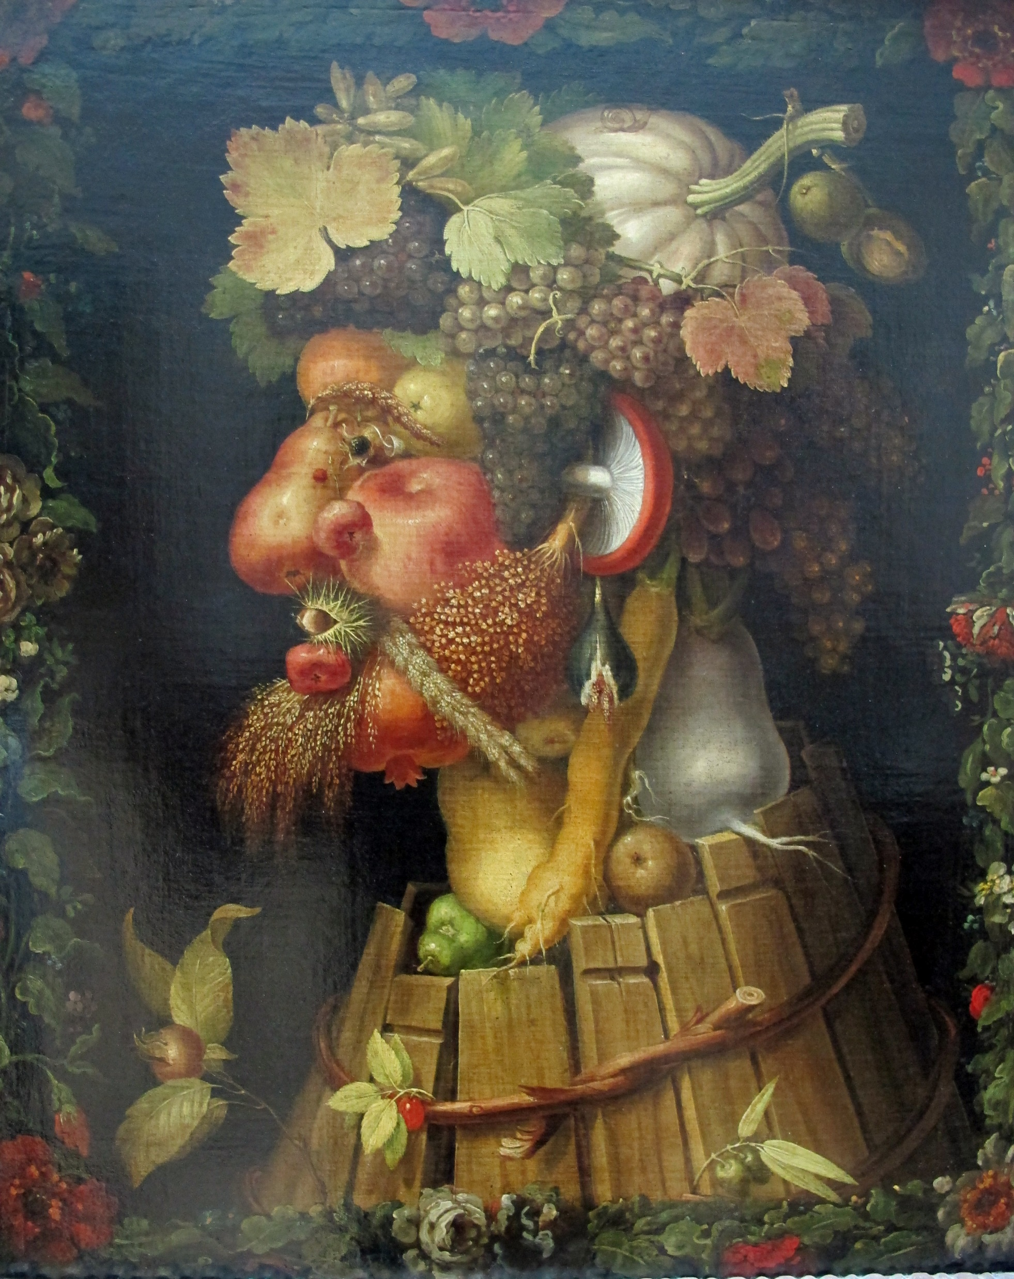
Autumn
A surly man with rough features looks to the left.
A neck of vegetables emerges from a broken vat, bound together by willow branches.
A face of apples, pears, pomegranate and figs.
The hair is made of bunches of grapes topped off with a pumpkin bonnet.
This Photo by Unknown Author is licensed under CC BY-SA

Slide 7
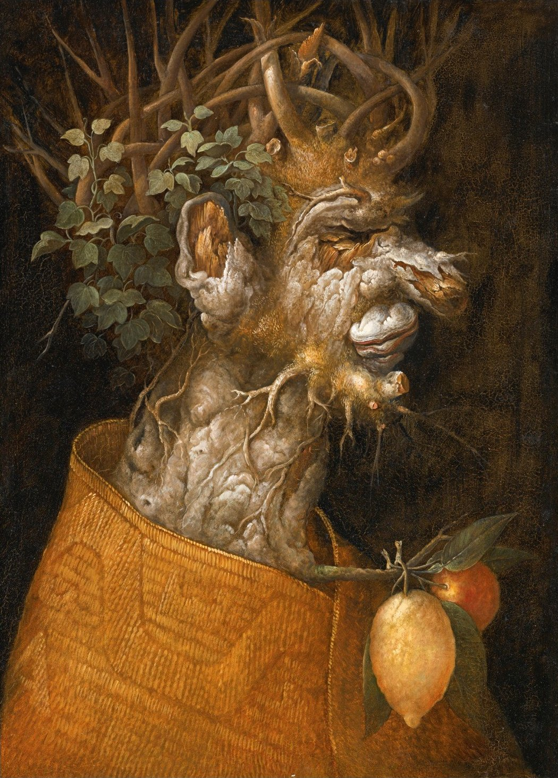
Winter
An old man facing right with skin of gnarled wood, representing the wrinkles of age.
A thin and poorly groomed beard of roots.
The hair is a series of branches entwined with ivy leaves.
Only a lemon and orange hang from his clothing. Citrus being the only winter fruit in Italy.
This Photo by Unknown Author is licensed under CC BY-SA

Slide 8
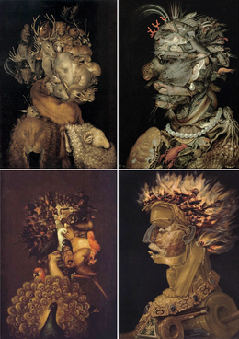
The Four Elements
The Four Seasons is analogous to Arcimboldos set of our paintings ‘The Four Elements’ with Air=Spring, Fire=Summer, Earth=Autumn and Water=Winter.
The pairing is said to link themes of chaos brought into harmony and the glorification of the Habsburg Dynasty.
This Photo by Unknown Author is licensed under CC BY-SA

