Slide 1
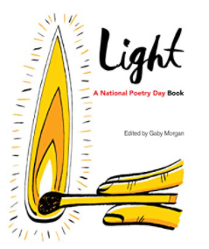
A free Kindle poetry book to celebrate National Poetry Day 2015 with poems on the theme of light
Editor Gaby Morgan
National Poetry Day Oct 1st 2020
Theme Vision

Slide 2
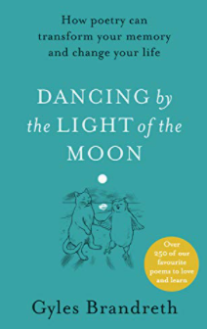

Slide 3
What can a poem do for you?
A good companion
Comforting link with the past
A challenge ... What is it all about?
Make you laugh, feel, think
Stretch your vocabulary
Help you get to sleep
An Ice Breaker..
“Painting is silent poetry and Poetry is Painting that speaks” (Plutarch)

Slide 4
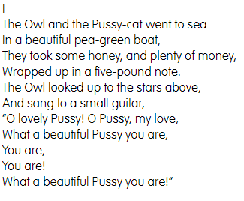
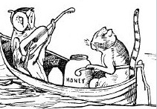
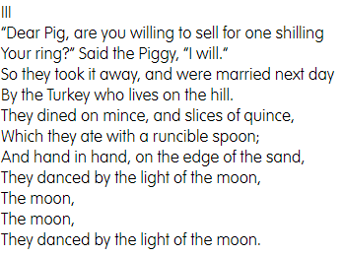
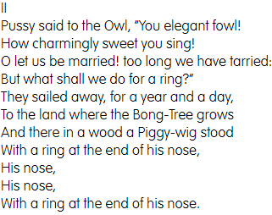
The Owl and the Pussy Cat – Edward Lear

Slide 5
Light as Birds – Liz Brownlee
Birds see shades
to us unseen,
the in-betweens
of every green
And red with blue;
they see UV,
a secret universe
Of hue.
No wonder birdsong
overflows, dizzy
with blues of sky.
Bird, is your song
of colour trails?
Is the air, in which you fly?

Slide 6
The meaning - Light as Birds
Humans have 3 receivers of coloured light = Cones
Specialised to see primary colours: Red, Green and Blue
Enables us to see VIBGROY
Songbirds have an extra cone – receives UV light
See colours beyond violet spectrum and shades we cannot see....

