Slide 1
Land Art
Andy Goldsworthy
Richard Long

Slide 2
ANDY GOLDSWORTHY British sculptor, photographer and environmentalist who produces site specific and land art. He lives and works in Scotland
This Photo by Unknown Author is licensed under CC BY-SA-NC
This Photo by Unknown Author is licensed under CC BY

Slide 3
Circles and spirals in nature
This Photo by Unknown Author is licensed under CC BY-NC-ND
This Photo by Unknown Author is licensed under CC BY-SA-NC

Slide 4
This Photo by Unknown Author is licensed under CC BY

Slide 5
Using natural materials
This Photo by Unknown Author is licensed under CC BY
This Photo by Unknown Author is licensed under CC BY

Slide 6
Colour contrasts
This Photo by Unknown Author is licensed under CC BY-NC-ND
This Photo by Unknown Author is licensed under CC BY-SA

Slide 7
Using leaves
This Photo by Unknown Author is licensed under CC BY-NC-ND
This Photo by Unknown Author is licensed under CC BY-SA-NC

Slide 8
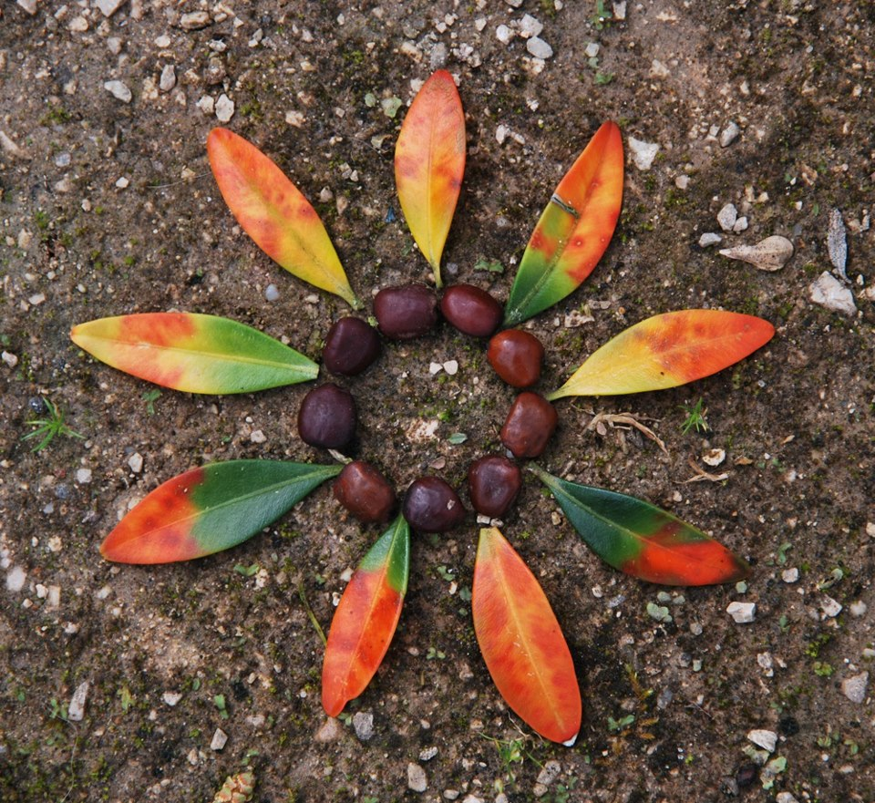
Nature mandalas - leaves
This Photo by Unknown Author is licensed under CC BY
This Photo by Unknown Author is licensed under CC BY-NC-ND
This Photo by Unknown Author is licensed under CC BY-SA-NC

Slide 9
Leaves and flowers
This Photo by Unknown Author is licensed under CC BY-SA-NC
This Photo by Unknown Author is licensed under CC BY-NC-ND

Slide 10
Nature mandalas
This Photo by Unknown Author is licensed under CC BY
This Photo by Unknown Author is licensed under CC BY-NC-ND

Slide 11
Patterns in nature
This Photo by Unknown Author is licensed under CC BY-SA-NC

Slide 12
Shells and stones
This Photo by Unknown Author is licensed under CC BY-NC-ND
This Photo by Unknown Author is licensed under CC BY

Slide 13
Richard Long Lives and works in Bristol. Longs art is about freedom, lightness and mobility. It often involves the walk as part of the artwork; marking place, locality, time, distance and measurement. He looks at how raw materials affect his humanity and scale in the reality of a landscape. Spirals and circles are often used to reflect natural patterns.
This Photo by Unknown Author is licensed under CC BY-SA-NC

Slide 14
Richard Long has been short listed for the prestigious Turner Prize four times.
This Photo by Unknown Author is licensed under CC BY-SA
This Photo by Unknown Author is licensed under CC BY-SA
This Photo by Unknown Author is licensed under CC BY-NC-ND

Slide 15
Stones in circles
This Photo by Unknown Author is licensed under CC BY-SA-NC
This Photo by Unknown Author is licensed under CC BY-NC-ND

Slide 16
His work sits well in a gallery space too
This Photo by Unknown Author is licensed under CC BY-SA-NC
This Photo by Unknown Author is licensed under CC BY-SA-NC

Slide 17
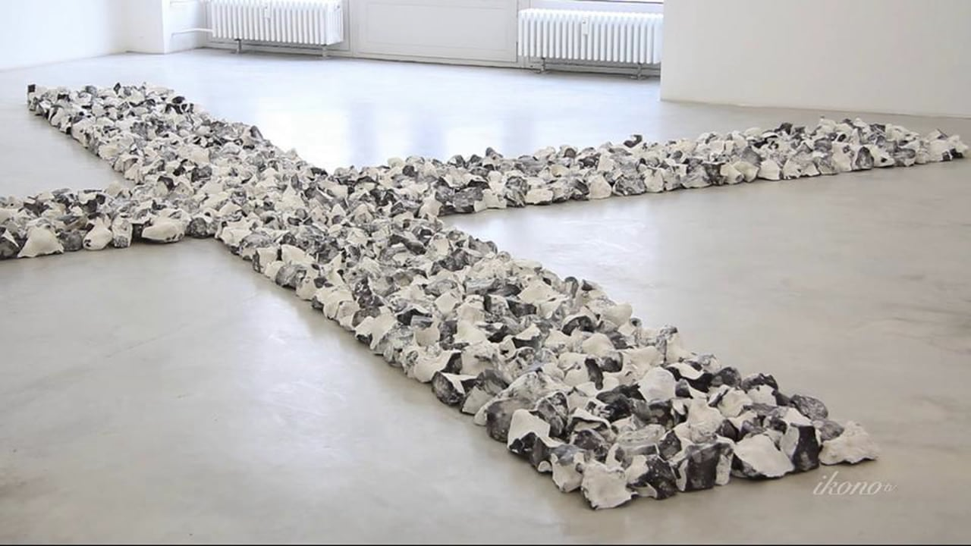
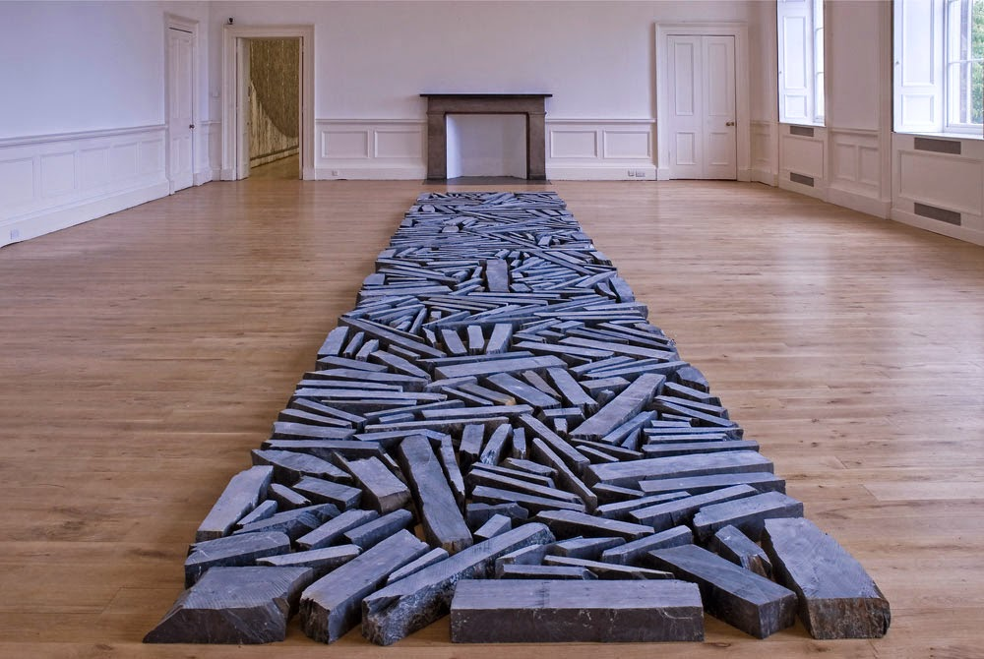
Stones and straight lines
This Photo by Unknown Author is licensed under CC BY-SA
This Photo by Unknown Author is licensed under CC BY-SA-NC
This Photo by Unknown Author is licensed under CC BY-NC-ND
This Photo by Unknown Author is licensed under CC BY-SA

Slide 18
Circles and spirals
This Photo by Unknown Author is licensed under CC BY-SA-NC
This Photo by Unknown Author is licensed under CC BY-NC-ND

Slide 19
Mud works
This Photo by Unknown Author is licensed under CC BY-NC-ND
This Photo by Unknown Author is licensed under CC BY-NC-ND

